Slide 1

Project Presentation

Slide 2
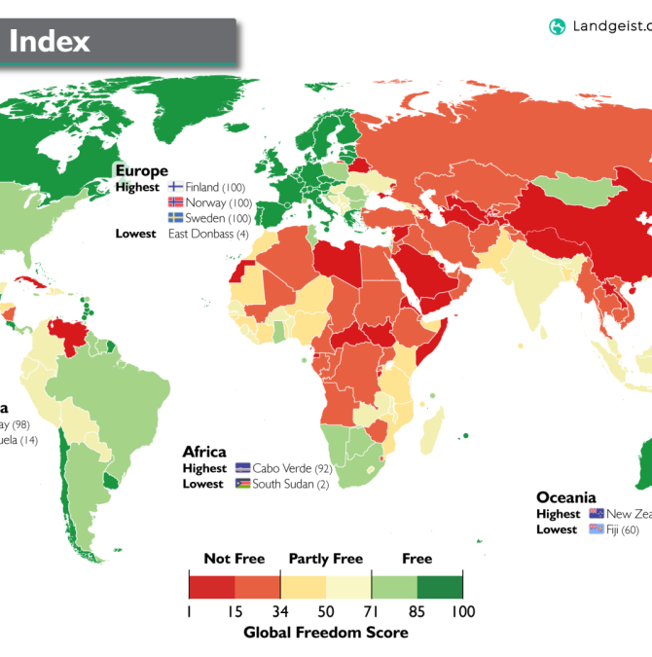
Table of contents
Information about our data set
Features of our data set
Our research question
Factors that we will consider
Graphs, charts, representation of our data

Slide 3
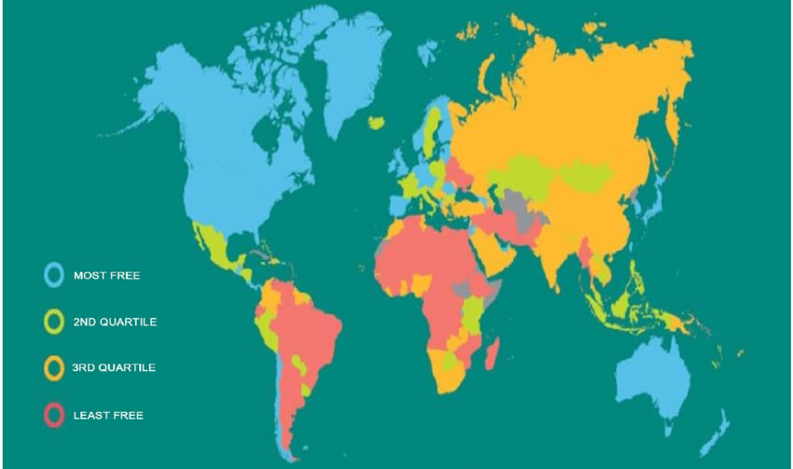
World Economic Freedom from 1970-2022
Today we are going to look at scores of economic freedom of different countries of the world. This chart represents economic freedom in 2018. We can see that the most free countries are: USA, Australia, Norway. Least free countries are countries in South America and in Africa.

Slide 4
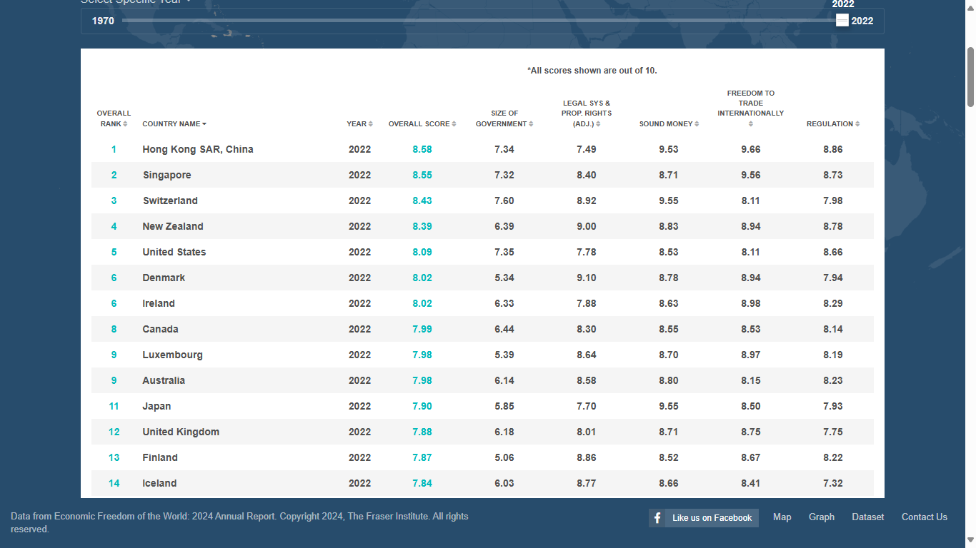
Information about our dataset
The Data set measures and evaluates and ranks 165 of the worlds' nations Economic Freedom based on 5 major criteria of Size of Government, Legal System & Prop. Rights, Sound Money, Freedom to Trade Internationally, and Regulation. We can filter our data by different criteria: custom, top 10 countries, economic freedom quartile, all countries. Also, we can find a country that we want to look for and choose the specific year.

Slide 5
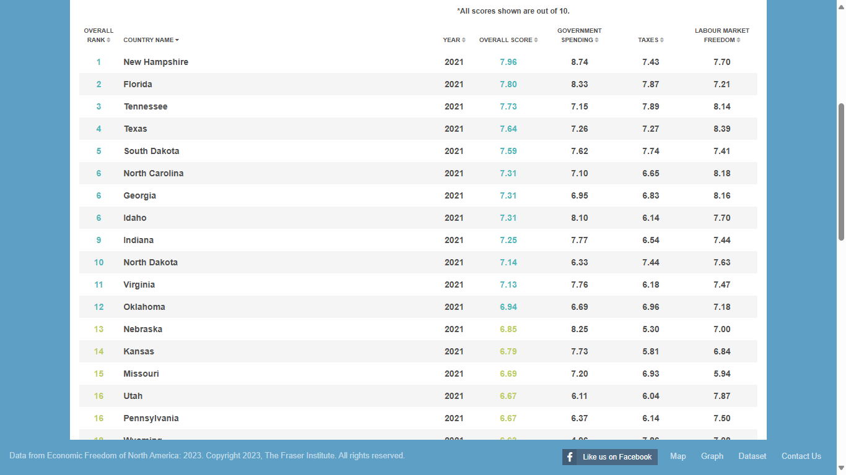
More features of our dataset
Our dataset allows us to find information about North America and US states. We can filter data from 1981-2021. On this image we can see economic freedom of US states in 2021. Overall score is based on government spending, taxes and labor market freedom.

Slide 6
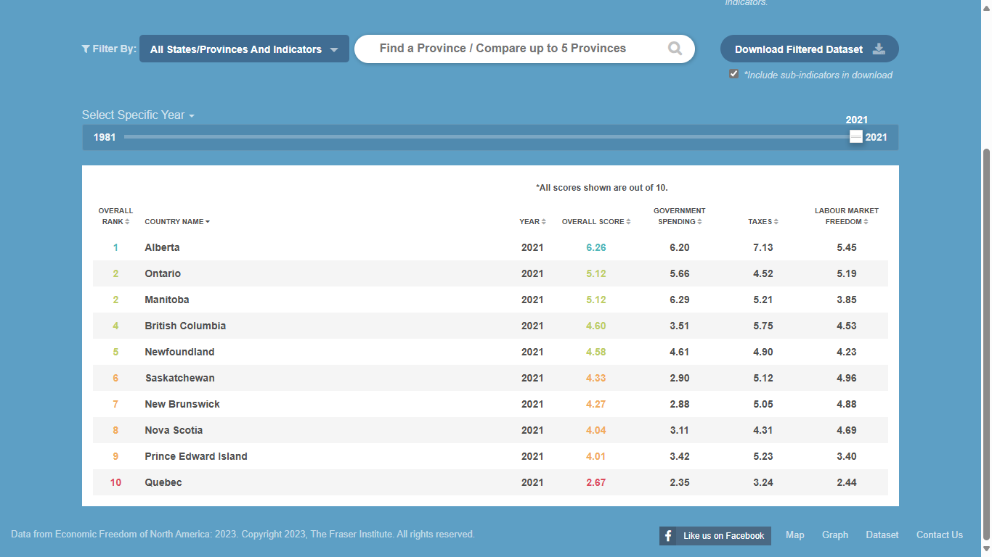
Canadian Provinces
We can see Canadian Provinces and their overall score of freedom from 1981 to 2021. In 2021 Alberta had the highest overall score of 6.26, while Quebec had the lowest overall score of 2.67.
This score is based on taxes, government spending, labor market freedom.

Slide 7
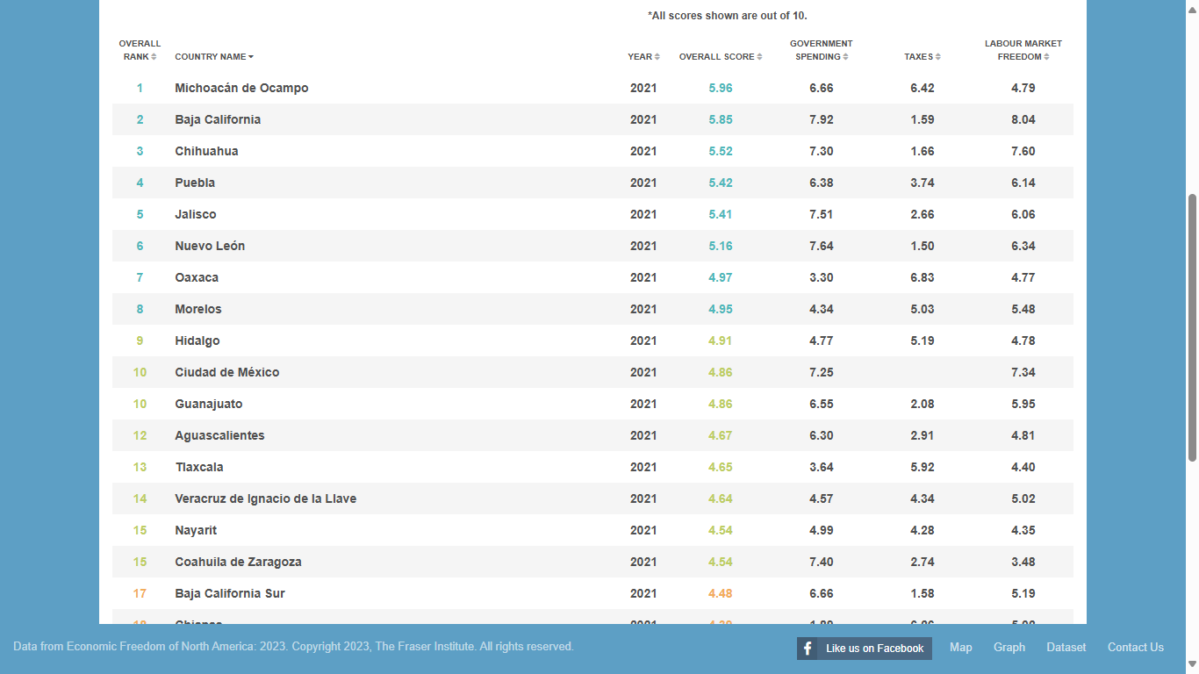
Mexico States
Lastly, we can see Mexico States and their economic freedom from 1981 to 2021. This score is based on taxes, government spending, labor market freedom.

Slide 8
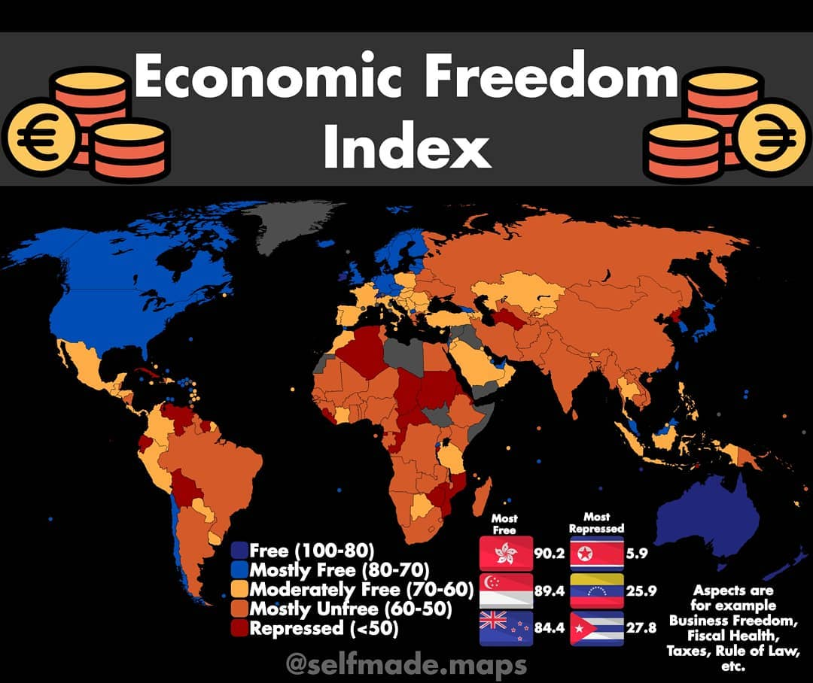
Our research question
Which country has the highest economic freedom in 2022 and what criteria, factors, features can influence the overall score of economic freedom?

Slide 9
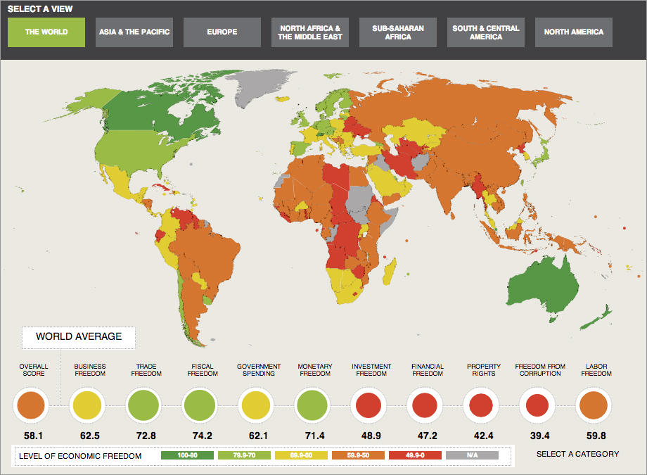
Factors that we will consider
Now we are going to use our recent data. We will be looking at data of year 2022. We will compare and consider different features to look what criteria has the biggest influence on overall score of economic freedom.

Slide 10
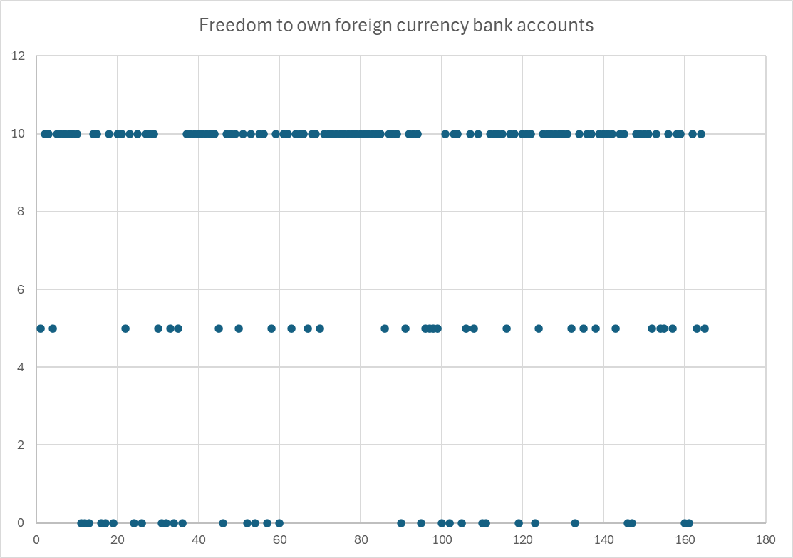
Freedom to own foreign currency bank accounts
The freedom to own foreign currency bank accounts is an important aspect of economic freedom, as it grants individuals and businesses the ability to hold, save, and transact in currencies outside of their national currency. This freedom can enhance economic stability, protect personal wealth, and have open economic environment. This chart represents freedom to own foreign currency bank accounts. On the top we can see so many dots-it means that many countries has highest freedom. Countries like: Switzerland, Australia, New Zealand, Singapore. Some African and South American countries are at the lower level: Ghana, Bolivia, Colombia, Central African Republic.

Slide 11
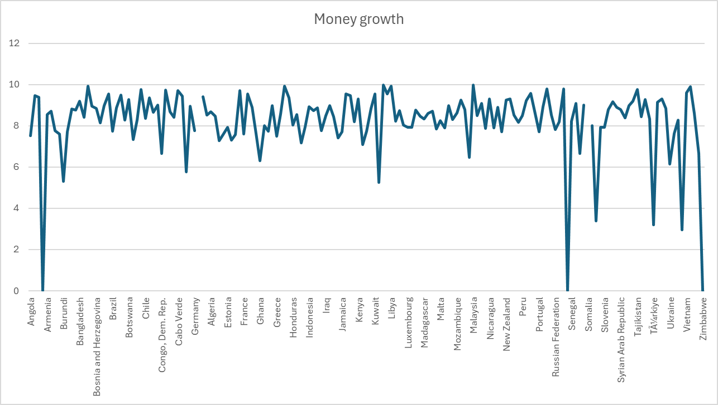
Money growth in different countries
This chart represents money growth in the countries. We can see and compare in which countries there is a decline or growth of money. Senegal, Somalia, Zimbabwe had a decline, while United Arab Emirates, Qatar, Saudi Arabia has growth of money. Rapid money growth can lead to high inflation, which negatively impacts economic stability. High inflation often leads governments to restrict foreign exchange, or limit market transactions to control inflationary pressures, which reduces economic freedom.

Slide 12
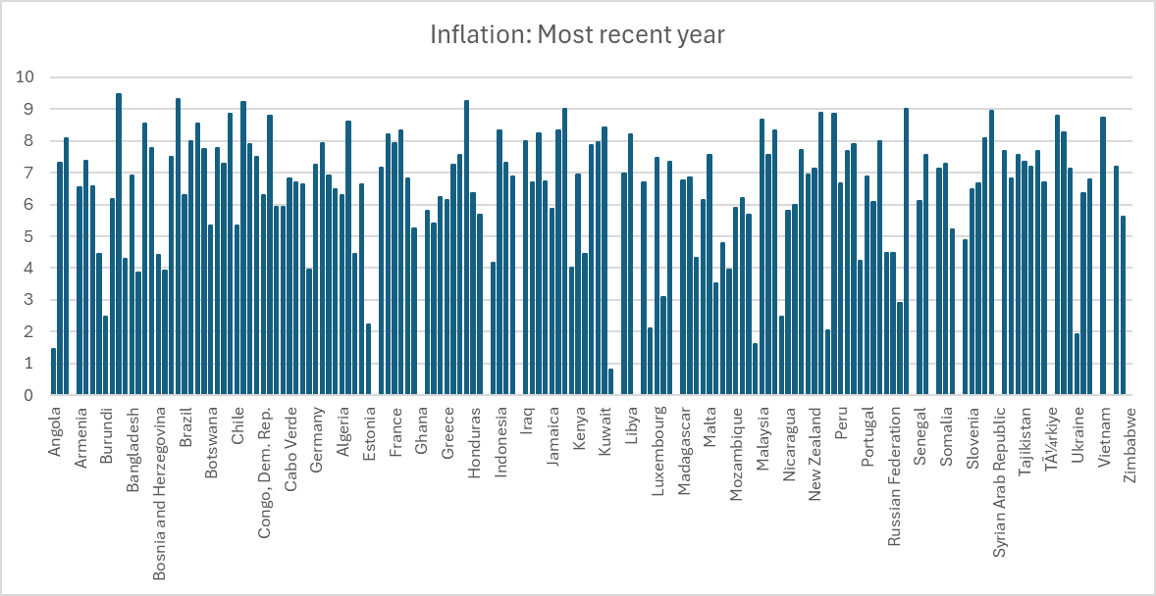
Inflation in countries for the recent year
High inflation reduces the purchasing power of individuals and businesses, limiting their ability to make autonomous decisions with their income. When prices rise rapidly, people can buy fewer goods and services, constraining their financial choices and reducing the overall economic freedom they experience in their daily lives. Bolivia, Zimbabwe, Mozambique has the highest inflation. Singapore, China, Switzerland has the lowest inflation.

Slide 13
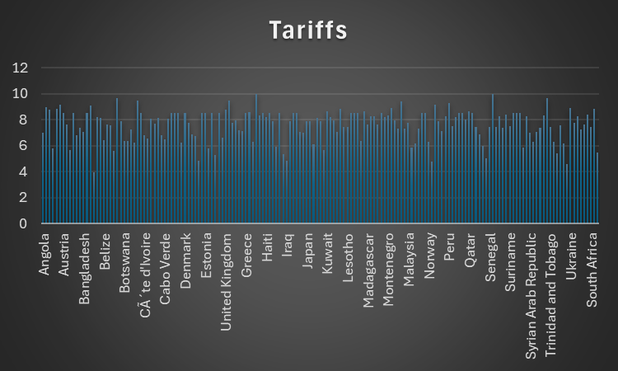
Tariffs in the countries
Tariffs can significantly impact economic freedom by influencing market dynamics, limiting choices for consumers and businesses. Tariffs increase the cost of imported goods, which restricts consumers’ ability to choose freely from a wider range of products. Tariffs reduce economic freedom by limiting choice, distorting prices, and increasing government intervention in the economy. Free and open markets generally offer greater economic freedom by allowing individuals and businesses to make their own decisions about buying, selling, and investing without government-imposed barriers. Highest tariffs are in Singapore, China, Chile, Bahrain. Smallest tariffs are in Nepal, South Africa, Argentina, the Bahamas

Slide 14
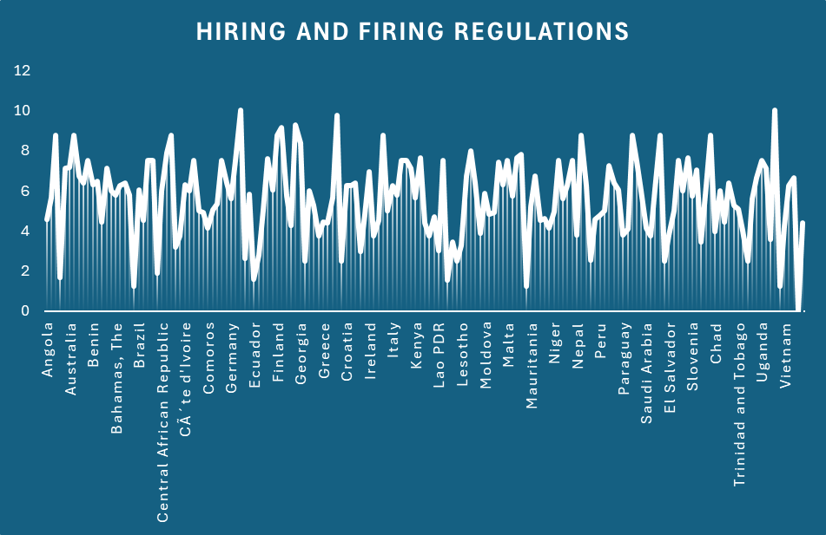
Hiring and firing regulations
Hiring and firing regulations can have a considerable impact on economic freedom, as they shape labor market dynamics, affect business flexibility, and influence individuals’ and firms' economic choices. Strict hiring and firing regulations limit businesses' ability to adjust their workforce in response to changing economic conditions. While hiring and firing regulations can protect workers’ rights and provide job security, they can also reduce economic freedom by limiting business flexibility, discouraging entrepreneurship, and distorting labor market dynamics. Denmark, China, USA has the highest level of the regulations and Venezuela, Bolivia, Liberia lowest level of the regulations.

Slide 15
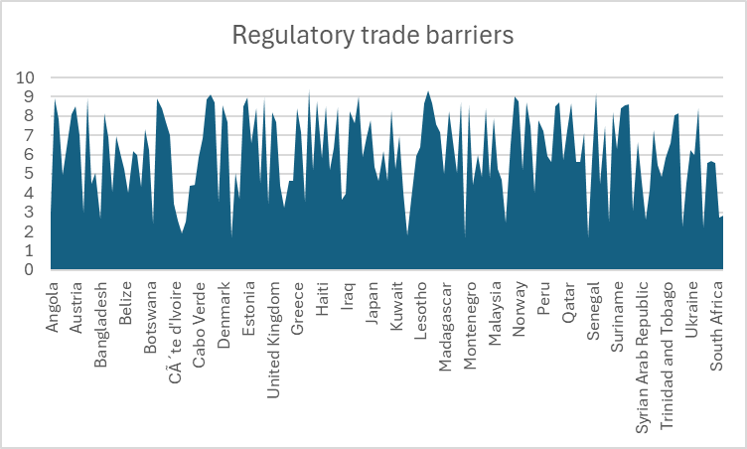
Regulatory trade barriers
Regulatory trade barriers, such as strict product standards, can limit the range of imported goods available to consumers. This reduces consumer freedom to choose from a diverse array of products, potentially resulting in higher prices and fewer options. While regulatory trade barriers can protect specific domestic interests, they limit on economic freedom by restricting market access, limiting consumer choices, and raising compliance costs for businesses. Highest regulatory trade barriers are in Luxembourg, Albania, Czech Republic, Slovenia. Lowest trade barriers are in Sudan, Congo, Algeria.

Slide 16
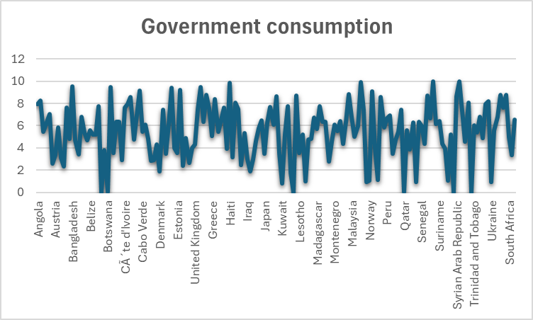
Government consumption
Government consumption, or government spending on goods and services, affects economic freedom by influencing the balance between public and private sector roles in an economy. Government spending requires funding, often raised through taxes. Higher government consumption can lead to higher taxes, reducing income. In economies with high government consumption, businesses may face uncertainty, as more government intervention can create regulatory or bureaucratic barriers. Highest government consumption are in African countries: Chad, Nigeria, Congo. Lowest government consumption are in Netherlands, Norway, Denmark.

Slide 17
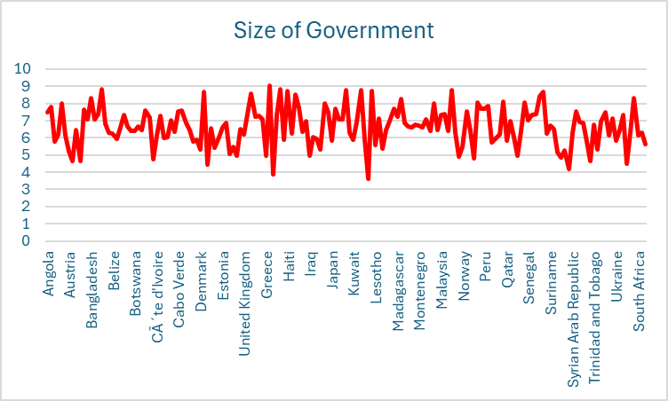
Size of Government
The size of government—referring to the extent of government involvement in economic activities through spending, taxation, and regulation—has significant implications for economic freedom. A large government typically requires higher taxes to sustain its spending. In countries with large governments, high taxes and regulatory burdens can make businesses less competitive internationally. The biggest size of government is in Somalia, Nigeria, El Salvador, Dominican Republic. The smallest size of the government is in Azerbaijan, Belgium, Rwanda, Venezuela.

Slide 18
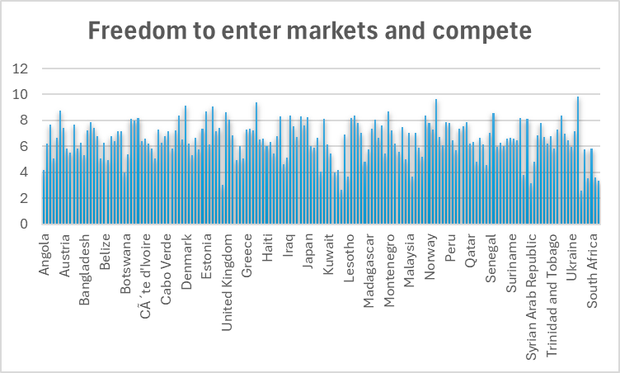
Freedom to enter markets and compete
The freedom to enter markets and compete is a critical component of economic freedom, playing a significant role in innovation, efficiency, and overall economic growth. Freedom to enter markets and compete is fundamental to economic freedom. It creates a competitive environment that drives innovation, improves consumer choices, enhances resource allocation. Highest freedom to enter markets and compete in China, New Zealand, USA. Lowest freedom to compete in Botswana, Venezuela, Libya

Slide 19
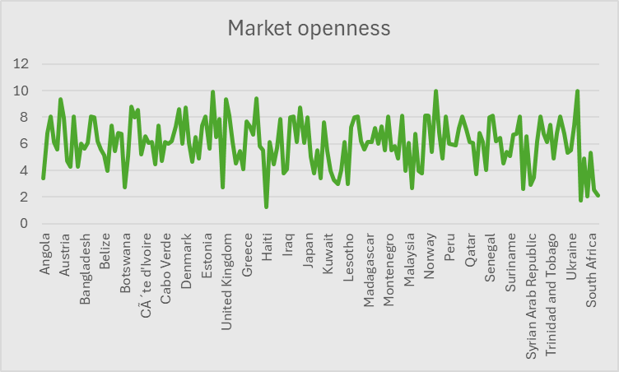
Market openness
Openness to international markets introduces foreign competitors into the domestic market, which can lead to lower prices and improved quality of goods and services. When markets are open, consumers have access to a broader range of products and services from different countries. Market openness is a fundamental component of economic freedom. It promotes competition, enhances consumer choice, attracts investment, contributes to economic growth. The highest market openness is in China, New Zealand, Finland, USA. The lowest market openness is in Venezuela, Zimbabwe, Yemen.

Slide 20
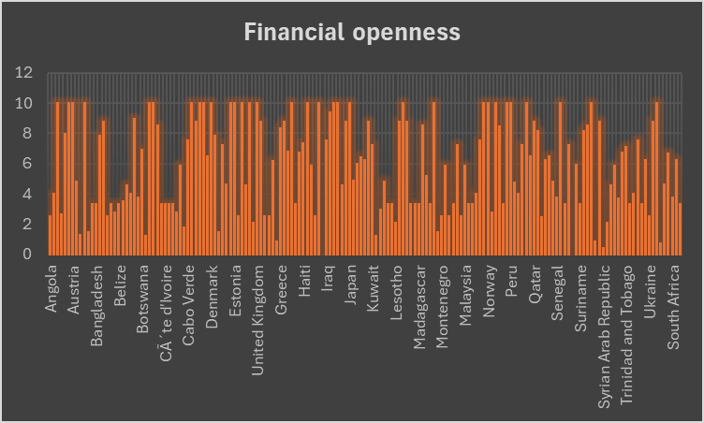
Financial openness
Financial openness refers to the capital to flow freely across its borders, including foreign investments, portfolio investments, and the ability for individuals and businesses to hold foreign currency accounts. Financial openness allows businesses and individuals to access a broader range of financing options. By allowing capital to flow freely across borders, countries can unlock their economic potential and improve the quality of life for their citizens. Growing countries all over the world has the highest financial openness: Sweden, USA, Belgium, Singapore. Especially poor countries in Africa has the least financial openness: Chad, Ghana, Algeria

Slide 21
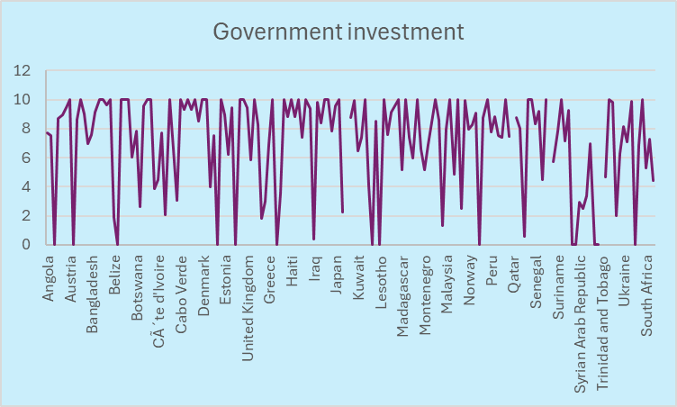
Government Investments
Government investments play a significant role in shaping economic freedom within a country. These investments can take various forms, such as infrastructure development, education, healthcare, and technology. Government investments in public goods, such as parks, libraries, and public transportation, enhance the quality of life for citizens. By looking at this graph we can see that government investments has involved in so many countries. Government investments play a vital role in shaping economic freedom by improving infrastructure education, healthcare, and innovation. Venezuela, Lybia, Bolivia didn't have any government investments at all.

Slide 22
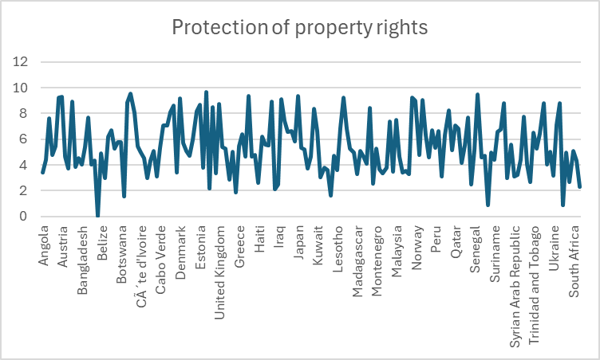
Protection of property rights
Property rights refers to the legal rights of individuals and businesses to own, use, and transfer property, including physical assets, intellectual property, and financial resources. Secure property rights contribute to economic stability by providing a predictable environment for economic activities. Property rights are essential for wealth creation and accumulation. When individuals can build and protect their assets, they can accumulate wealth over time, contributing to higher living standards and economic mobility. Highest protection is in Japan, USA, China. Lowest protection is in Libya, Somalia, Venezuela.

Slide 23
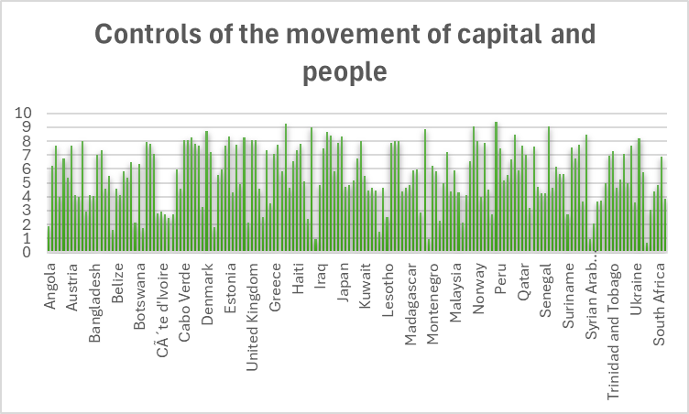
Controls of the movement of capital and people
Controls on the movement of capital and people refer to government restrictions that limit or regulate how money and individuals can flow across borders. Restrictions on the movement of people can limit tourism, which is an essential sector for many economies. Free movement of people promotes cultural exchange and collaboration, which can lead to innovation and new ideas. The highest control of the movement of capital and people are in Switzerland, Singapore, China. It means that these countries has strict regulations, conditions and rules. The lowest control is in the Chad, Iraq, Belize, Vietnam.

Slide 24
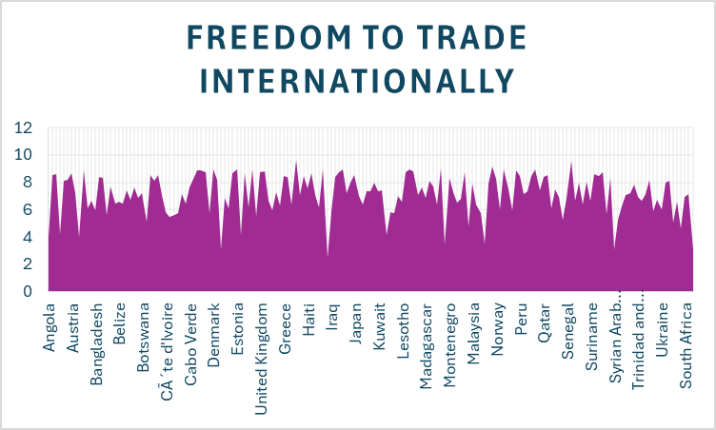
Freedom to trade internationally
The freedom to trade internationally is a crucial aspect of economic freedom, as it allows countries, businesses, and individuals to engage in cross-border exchanges of goods, services, and capital. This freedom is fundamental for promoting economic growth, enhancing competition, and improving the standard of living. With international trade, consumers gain access to a wider variety of goods and services, often at lower prices. By promoting free trade, countries can enhance their economic prosperity and improve the standard of living for their citizens. Most of the countries has the highest level of freedom to trade internationally. The most freedom countries to trade are Israel, Singapore, China, Switzerland, Austria. Countries that have some limitations are Niger, Syria, Iran, Algeria.

Slide 25
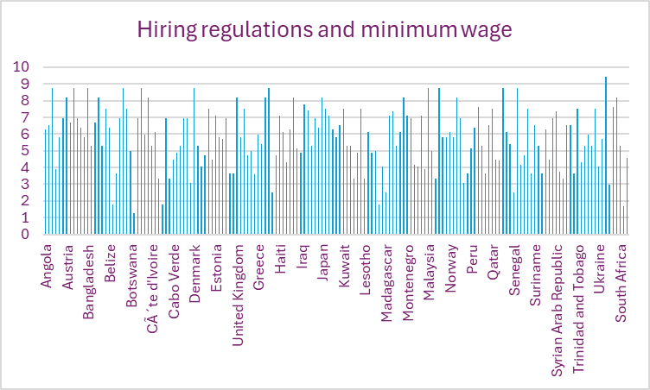
Hiring regulations and minimum wage
Regulations can either enhance or limit a company’s ability to hire the best talent. When hiring is heavily regulated, employers may be more cautious about taking on new employees. hiring regulations and minimum wage laws are essential elements of labor market policy that can have significant implications for economic freedom. While they are intended to protect workers and promote fair compensation, they can also create challenges that impact hiring, business operations, and overall economic dynamics. This chart clearly shows us difference in minimum wages in countries. USA, Switzerland, China, Denmark, Singapore has the highest minimum wages. Some countries such as Bolivia, Venezuela, Moldova, Brazil, Zambia has the lowest minimum wages.

Slide 26
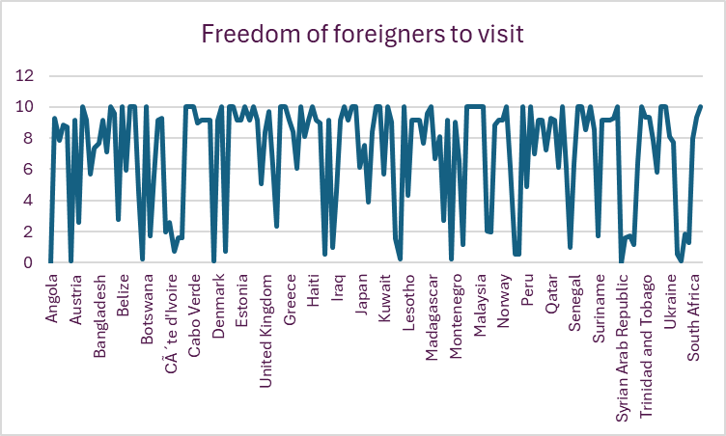
Freedom of foreigners to visit
The freedom of foreigners to visit a country is an important aspect of economic freedom that can have wide-ranging implications for both the host country and the visitors. Countries that are open to foreign visitors often signal a welcoming business environment. While facilitating the freedom of foreigners to visit is beneficial for economic freedom, it is also essential for countries to implement security measures that protect their citizens and infrastructure without overly restricting access to visitors. By improving travel and tourism, countries can unlock significant economic opportunities while enhancing global connections. The highest freedom to visit is in Austria, Dominican Republic, Philippines, Poland. The lowest freedom is in Libya, Pakistan, Angola, Venezuela.

Slide 27
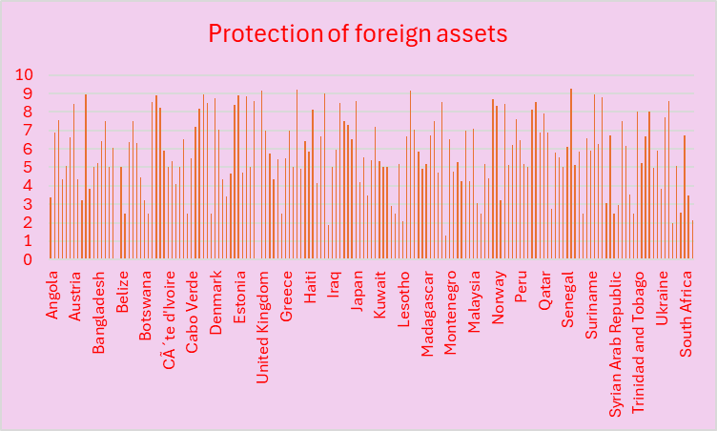
Protection of foreign assets
The protection of foreign assets is a critical element of economic freedom, influencing international investment, trade relationships, and overall economic stability. When foreign assets are protected, countries can attract a diverse range of investments across various sectors, including infrastructure, technology, and manufacturing. Protecting foreign assets can strengthen trade relationships between countries. Protection of foreign assets impacts investment, trade, economic development. Highest level of protection of foreign assets are in Norway, China, Singapore, USA. Lowest level of protection of foreign assets are in Iran, Brazil, Montenegro, Chad.

Slide 28
The most economic freedom countries in 2022
Using our data we can conclude the most free countries in the world in 2022:
Hong Kong
Singapore
Switzerland
New Zealand
United States
Denmark and Ireland
8. Canada
9. Luxembourg and Australia

Slide 29
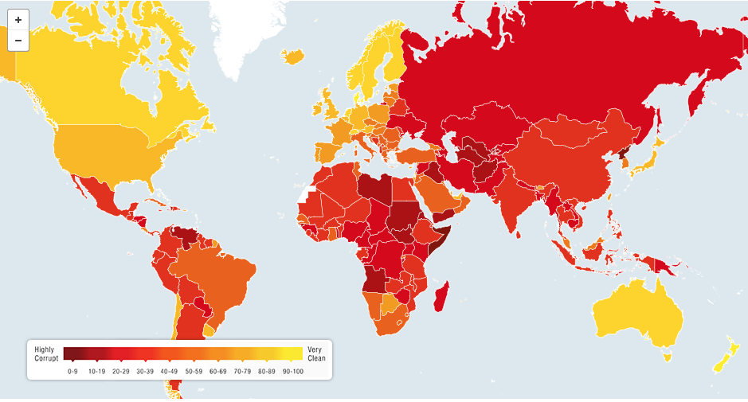
Our results and conclusion
Today we dived into economic freedom and we saw how many different factors are important. We have looked at market and financial openness, tariffs, money growth, size of government and government investments, freedom of trade and freedom of foreigners, inflation. In conclusion, economic freedom can lead to driving growth, innovation, and individual prosperity. It empowers individuals, attracts investment, contributing to overall economic development.

Slide 30

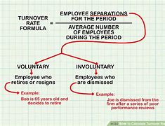
Our second research question: What combination of Size of Government and Turnover Rate would contribute to a stronger economy?

Slide 31
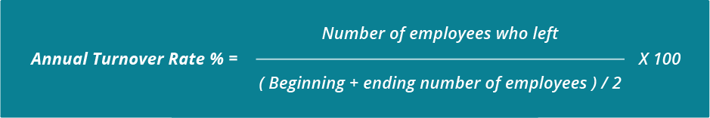
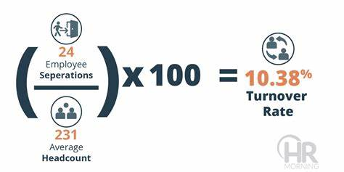
What is Turnover rate?
Turnover rate- refers to the percentage of employees who leave a company within a certain time, which is then replaced by new employees. This rate is often used as an indicator of employee satisfaction, company culture, and overall operational health.
High turnover rates can suggest issues like poor job satisfaction, lack of career growth opportunities, or dissatisfaction with management. Conversely, a low turnover rate often signifies a healthy working environment that retains its employees effectively.

Slide 32
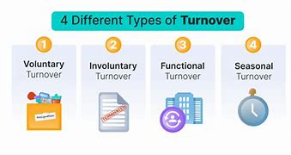
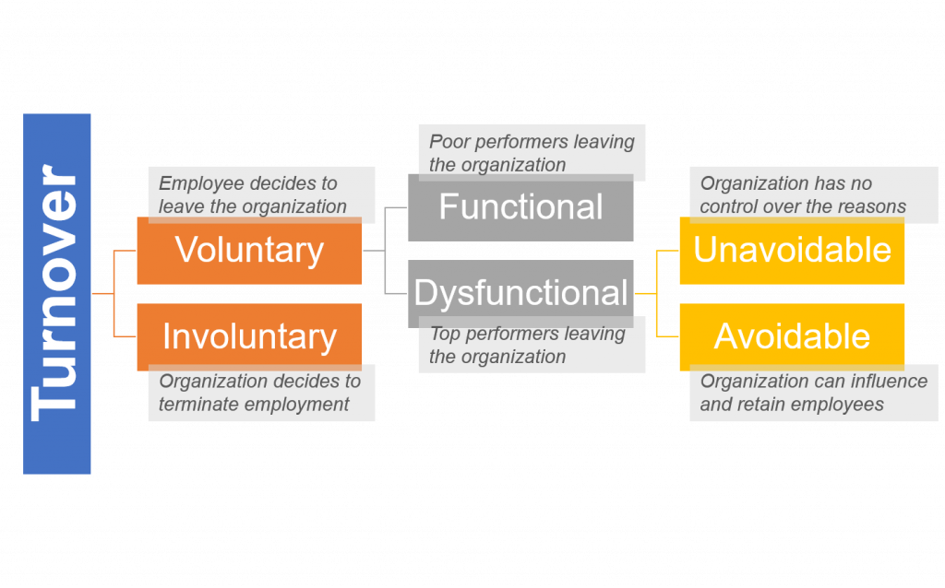
Types of turnover rate
Voluntary Turnover: Employees choose to leave their jobs willingly, often for reasons like better job opportunities, career growth, dissatisfaction with their role, or work-life balance needs.
Involuntary Turnover: Employees are terminated by the employer due to performance issues, restructuring, layoffs, or other organizational decisions.
Functional Turnover: poor performers leaving the organization
Dysfunctional Turnover: top performers leaving the organization
Unavoidable Turnover: organization has no control over the reasons
Avoidable Turnover: organization can influence and retain the employees.

Slide 33
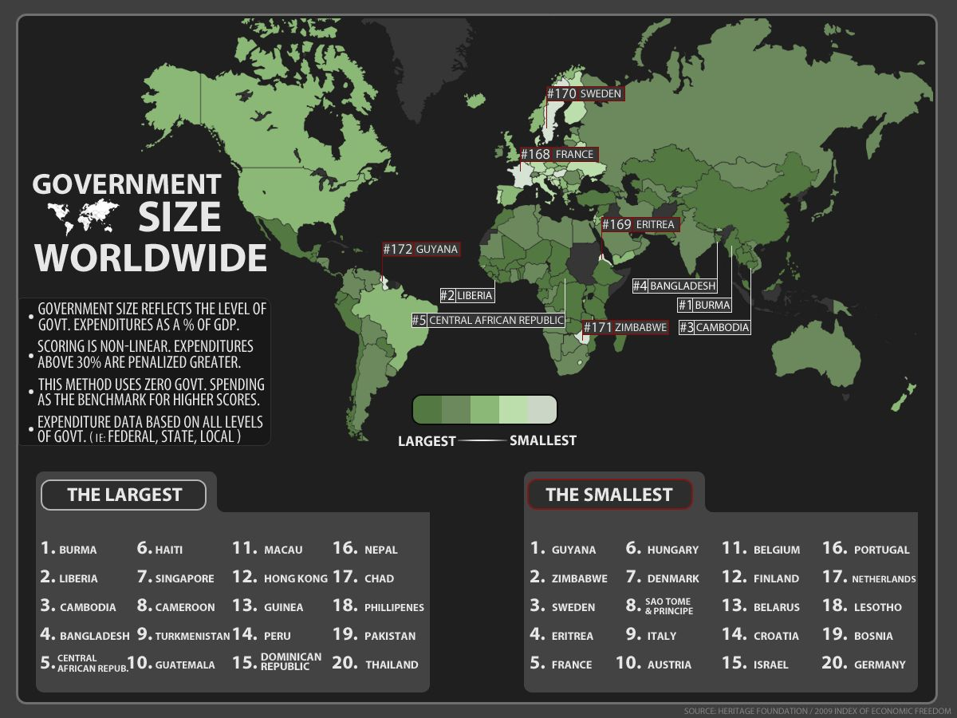
What is size of government?
The size of government typically refers to the extent of government involvement in a country’s economy, often measured by the share of government expenditures in relation to the gross domestic product (GDP). It can include different aspects such as government spending, taxation, employment, public ownership.

Slide 34
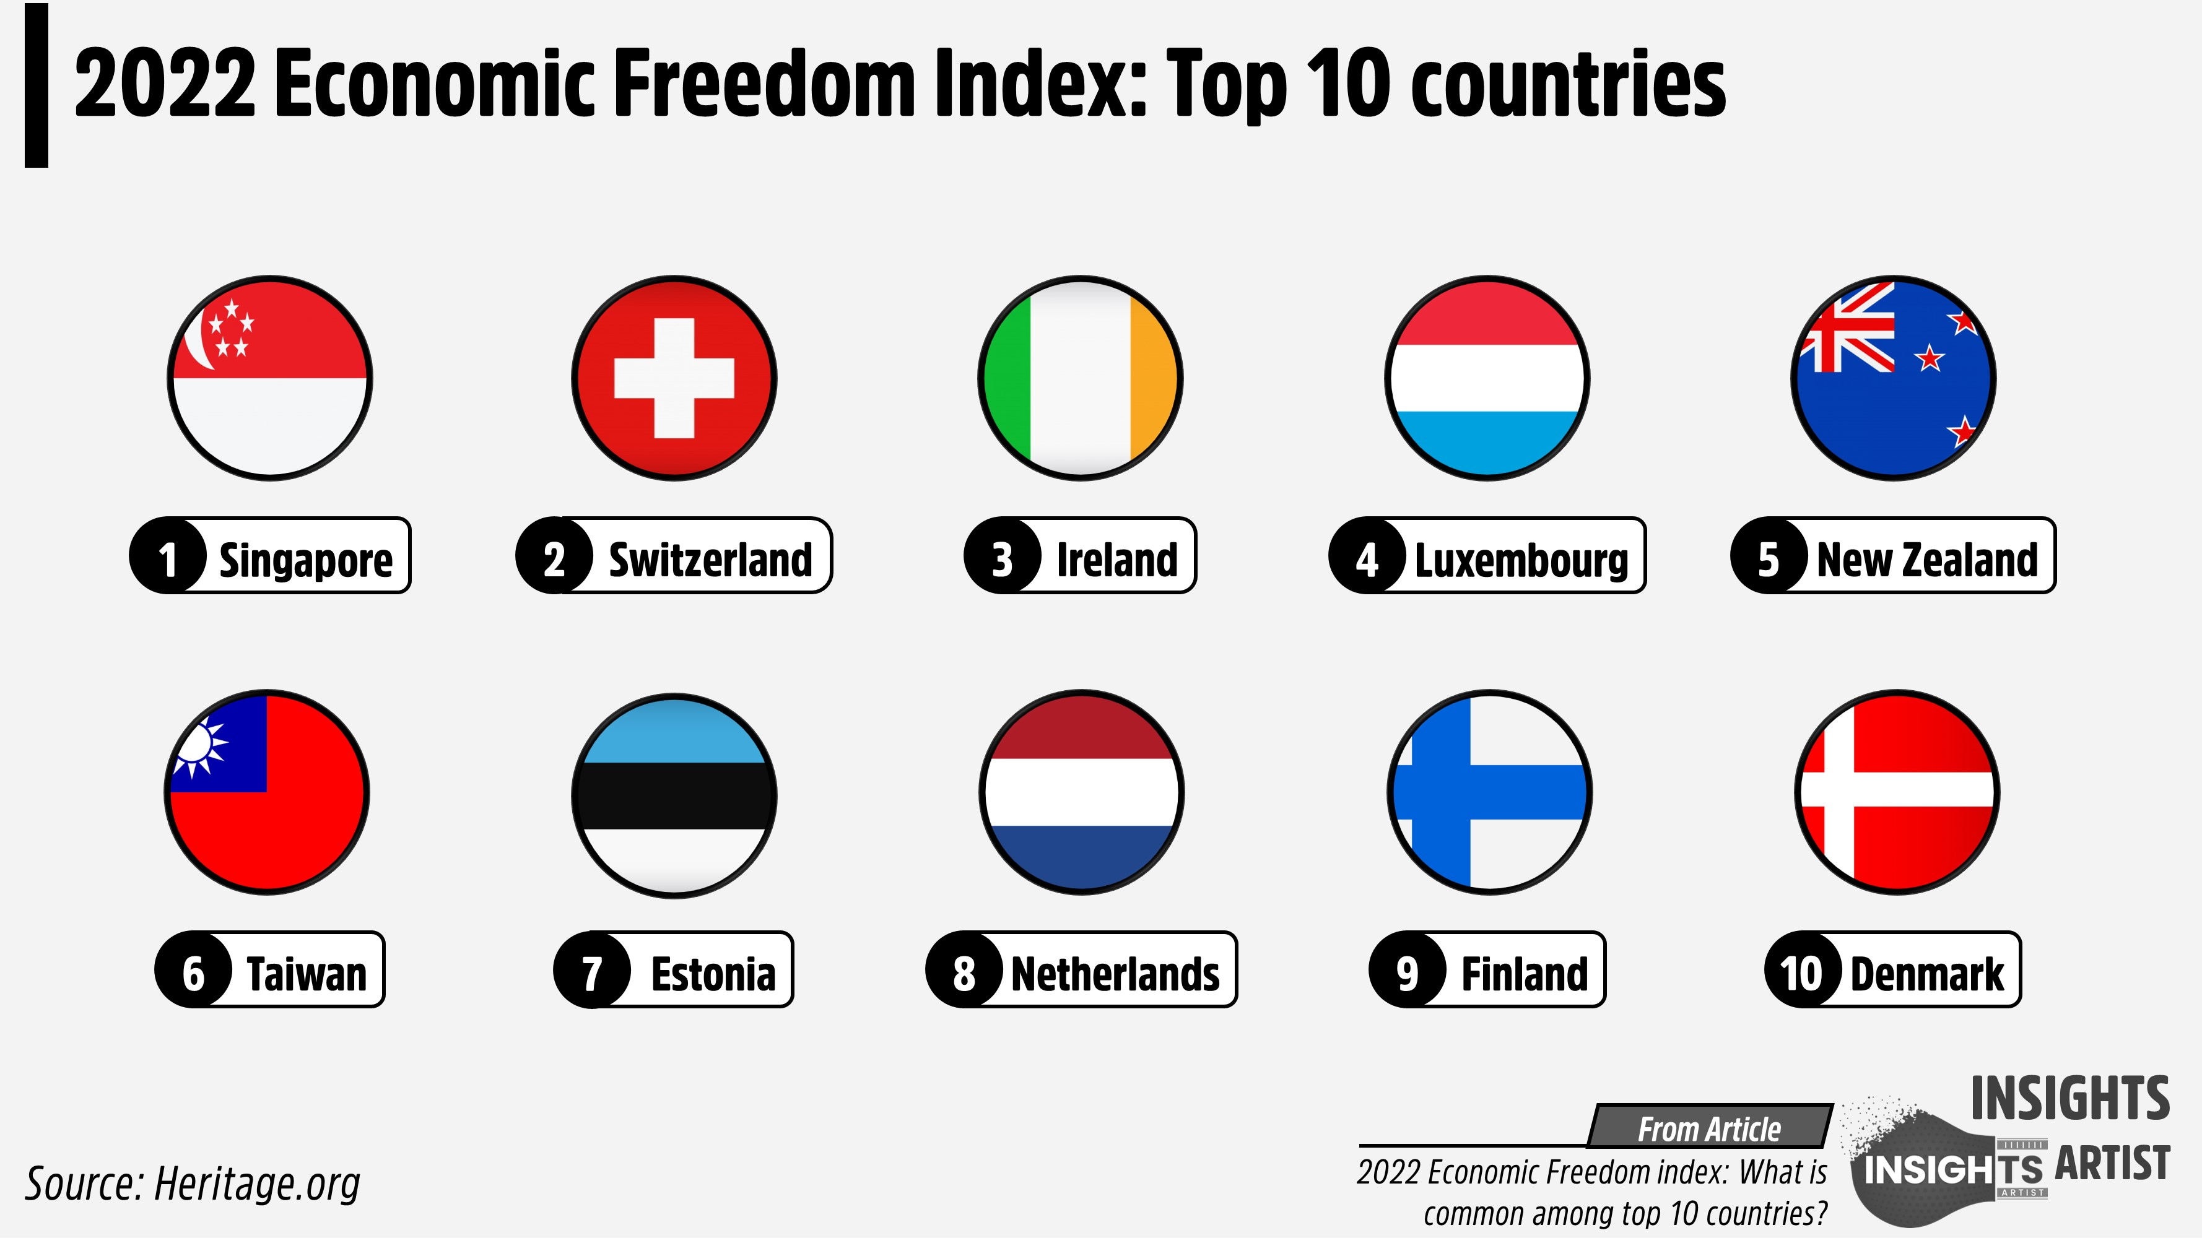
Impact of size of government on economic freedom and the economy

Slide 35
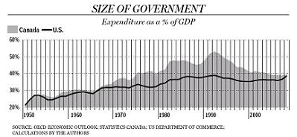
Relationship between size of government and Turnover rate
To analyze the relationship between the Size of Government and Turnover Rate in contributing to a stronger economy, we can consider the following points:
1.Size of Government:
A larger government size often indicates higher public spending, which can stimulate economic growth through infrastructure, education, and social services.
However, excessive government size can lead to inefficiencies, higher taxes, and potential crowding out of private investment.
2. Turnover Rate:
A high turnover rate in the labor market can indicate a dynamic economy where businesses are adapting to changes, leading to innovation and growth.
Conversely, very high turnover can also suggest instability, which may deter investment and reduce overall productivity.

Slide 36
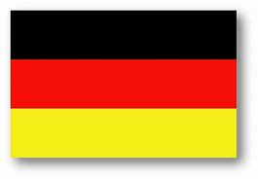

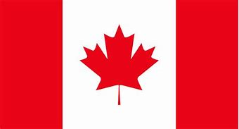
Combinations for a stronger economy
Moderate Size of Government + Moderate Turnover Rate:
This combination can provide a balance where the government supports essential services and infrastructure while allowing for a stable labor market that encourages innovation and productivity.
Countries that exemplify a moderate size of government combined with a moderate turnover rate often include:
Germany: Known for its strong social market economy, Germany balances government intervention with a robust private sector, resulting in moderate turnover rates and stable economic growth.
Canada: With a well-developed welfare system and a dynamic labor market, Canada maintains a moderate government size while encouraging job mobility and innovation.
Australia: Australia features a relatively small government compared to its GDP, alongside a labor market that allows for moderate turnover, fostering economic resilience and adaptability.

Slide 37
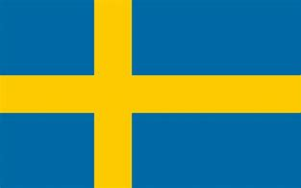
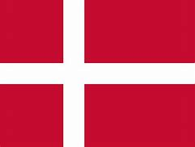

Combination #2
Larger Size of Government + Low Turnover Rate
This may work in scenarios where government spending effectively supports job security and stability, leading to a strong economy, especially in sectors like healthcare and education.
Countries that exemplify a larger size of government combined with a low turnover rate typically have extensive social welfare systems and stable labor markets. Examples include:
Sweden: Known for its comprehensive welfare state, Sweden has a large government that provides extensive social services, resulting in low labor market turnover due to job security and strong employee protections.
Denmark: Similar to Sweden, Denmark features a high level of government involvement in the economy, with generous unemployment benefits and job security, leading to low turnover rates.
France: France has a significant government presence in the economy, with strong labor laws and protections that contribute to lower turnover rates, although it faces challenges with unemployment.

Slide 38

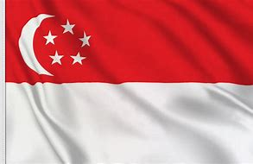

Combination #3
Smaller Size of Government + High Turnover Rate
This could foster a highly competitive environment, encouraging entrepreneurship and innovation, but may risk underfunding essential services.
Countries that exemplify a smaller size of government combined with a high turnover rate typically have less government intervention in the economy, fostering a dynamic labor market. Examples include:
United States: The U.S. has a relatively small government size compared to its GDP, with a high turnover rate in the labor market, driven by a culture of entrepreneurship and innovation.
Singapore: Known for its pro-business environment and minimal government intervention, Singapore experiences high labor market mobility, allowing for rapid adaptation to economic changes.
New Zealand: With a smaller government footprint, New Zealand encourages a flexible labor market, resulting in higher turnover rates as businesses and workers adapt to changing economic conditions.

Slide 39

The best combination for a stronger economy
Countries that exhibit a moderate government size combined with a balanced turnover rate tend to foster strong, stable economies. Here are a few examples:
1. Germany
Moderate Government Size: Germany has a well-developed social welfare system, but it maintains a relatively moderate government size compared to its GDP, focusing on efficiency and investment in key sectors like education, healthcare, and infrastructure.
Balanced Turnover Rate: The German labor market is known for its stability, supported by apprenticeship programs and strong labor protections. Workers have a high level of job security, but there is also enough mobility for workers to move into roles that better match their skills. This balance contributes to Germany’s status as Europe’s largest economy.
2. Switzerland
Moderate Government Size: Switzerland has a smaller government relative to other developed economies, with a strong emphasis on economic freedom, low taxes, and limited government intervention. However, it invests heavily in quality healthcare, education, and infrastructure, supporting a productive workforce.
Balanced Turnover Rate: Switzerland’s labor market is highly flexible, which allows companies to adjust to economic conditions while workers enjoy high wages and stability. This turnover rate is not overly high, meaning workers have opportunities without excessive instability, fostering a skilled, dynamic workforce.

Slide 40

Our third question: How do variations in top marginal tax rates and government subsidies affect the profitability and scalability of foreign subsidiaries in countries with strong vs. weak property rights protections?
Methodology
Compare the profitability and scalability of foreign subsidiaries in countries with strong versus weak property rights protections using Sound Money and Economic Freedom Factors.
Analyze how variations in top marginal tax rates and government subsidies correlate with profitability and scalability in these two groups.
Compare Findings

Slide 41
Key Terms
Profitability- refers to an ability to generate income or profit from operations over a given period. It indicates how effectively a revenue can be converted into profit and is a critical measure of financial health and performance.
Scalability- refers to an ability to handle increased demand, workload, or growth. It is a key consideration in business strategy, technology, and operations, indicating how well a process or structure can adapt to changes in size.
Foreign subsidiary is a company that is owned and controlled by another company based in another country. This type of business structure allows company to operate in a foreign market while maintaining a legal entity in the host country.
Property rights- refers to the legal rights of individuals and businesses to own, use, and transfer property, including physical assets, intellectual property, and financial resources.
Sound money refers to a stable and reliable monetary system that maintains its value over time, fostering economic stability and public trust.
Marginal tax rates refer to the percentage of tax applied to an individual’s or corporation’s income for each additional dollar earned within specific income brackets. It is a core concept in progressive tax systems, where higher income levels are taxed at higher rates.

Slide 42
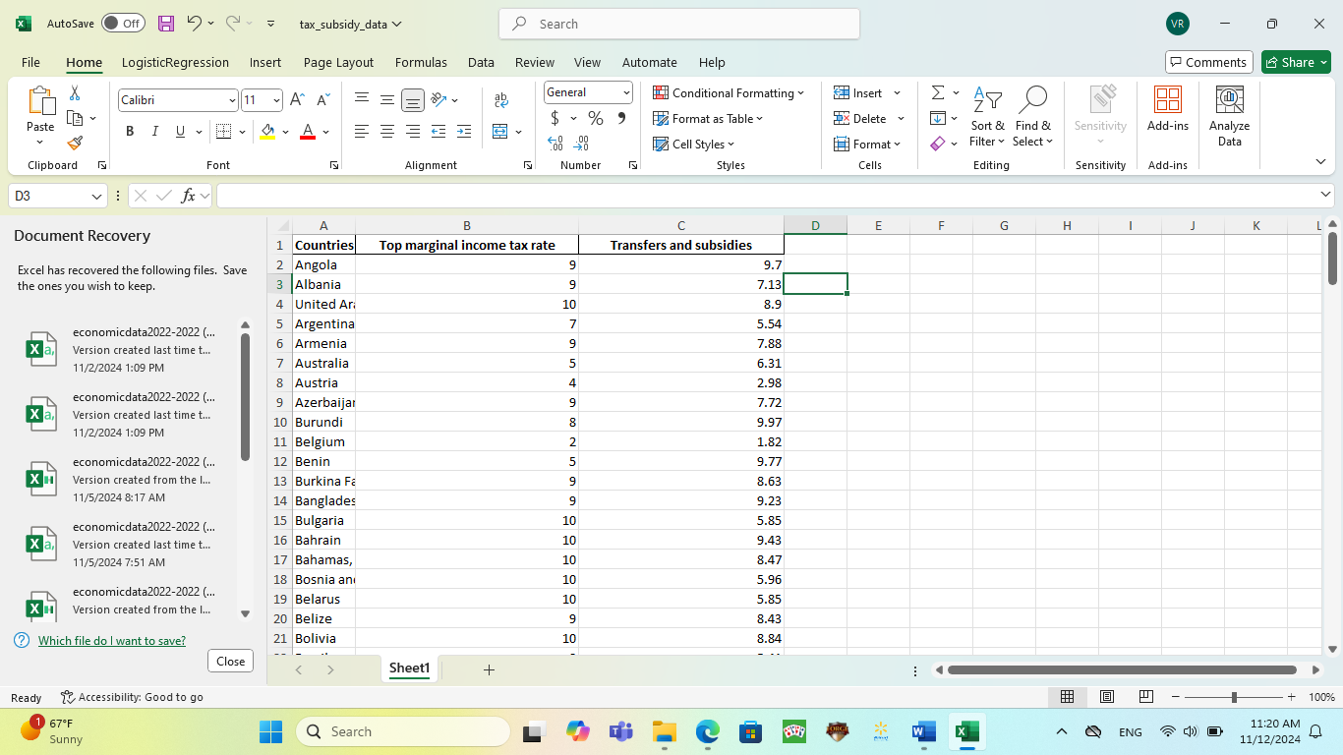
To analyze the correlation between top marginal tax rates and government subsidies:
extract the relevant columns from the dataset
clean the data to ensure it's numeric
calculate the correlation coefficient
This will help us understand the relationship between these two economic indicators

Slide 43
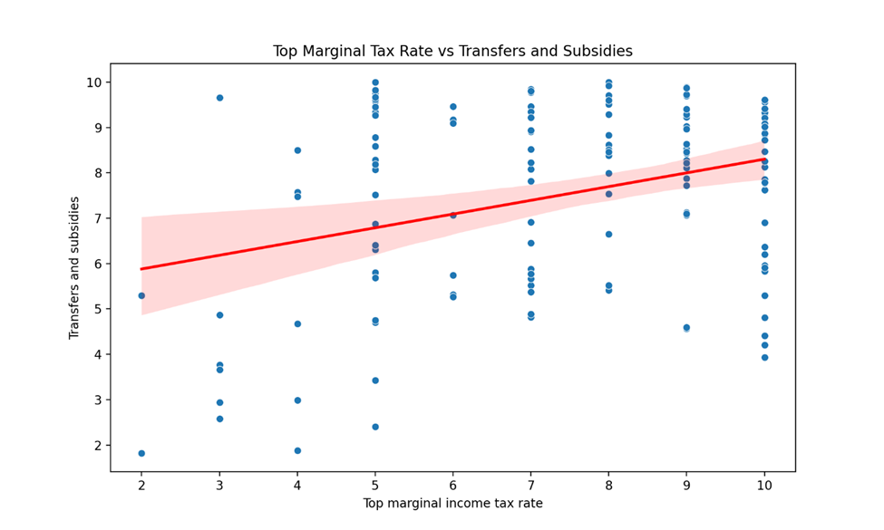
Calculated the correlation between top marginal tax rates and government subsidies, resulting in a correlation coefficient of approximately 0.32, indicating a moderate positive relationship. The scatter plot with a trend line visually represents this relationship.

Slide 44
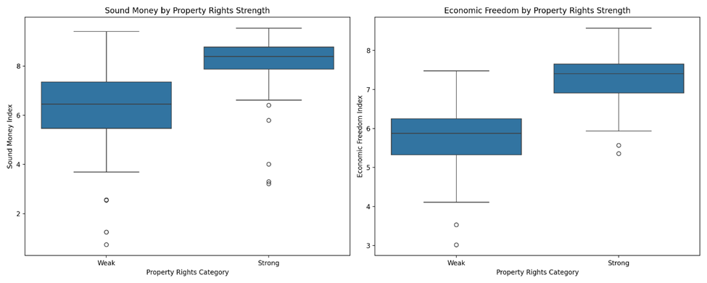
To compare the profitability and scalability of foreign subsidiaries in countries with strong versus weak property rights protections, we will first identify the relevant columns for property rights and profitability metrics. Then, we will categorize countries based on their property rights strength, calculate average profitability and scalability for each category, and visualize the results. Let's proceed with this analysis.
Calculated average metrics for "Sound Money" and "Economic Freedom Summary Index" for each category
The correlation matrix provides insights into the relationships between these variables.
The visualizations illustrate the differences in these metrics between countries with strong and weak property rights protections.

Slide 45
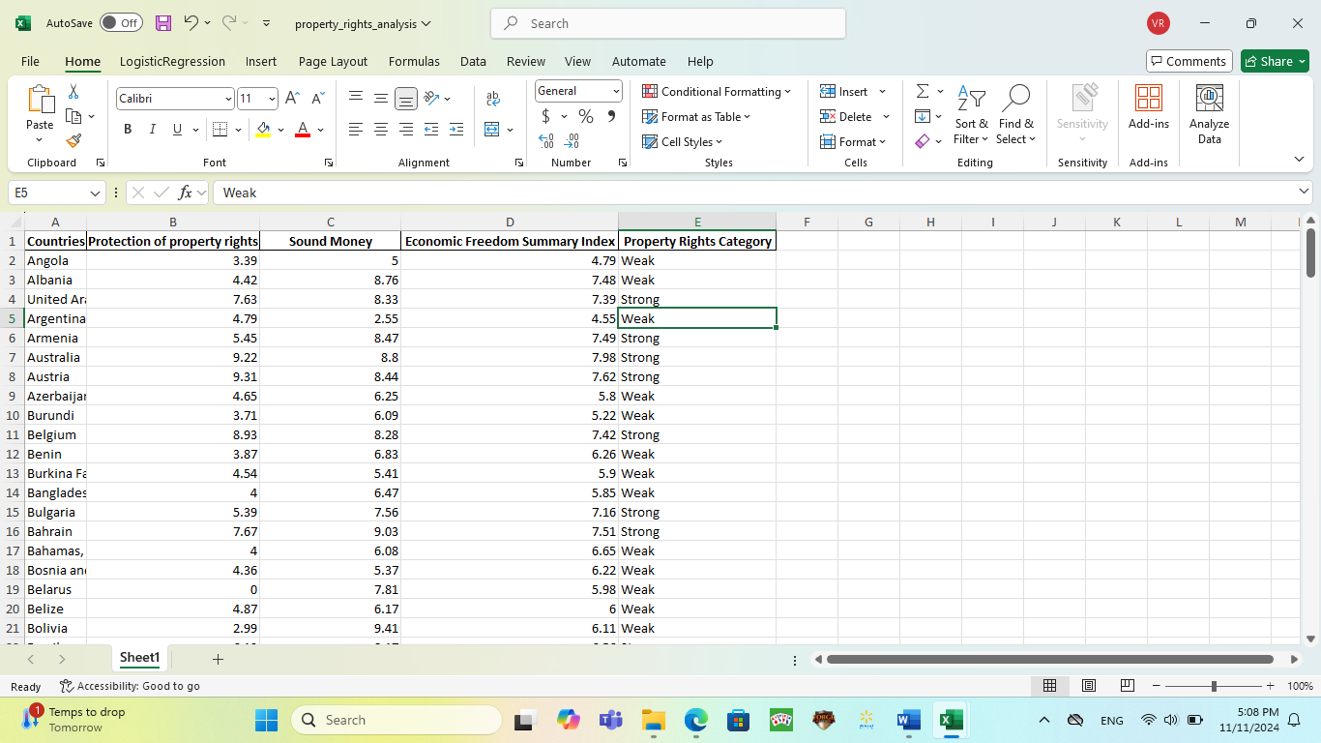
Sound Money Index:
Countries with strong property rights show notably higher sound money scores
Less variability in sound money metrics for countries with strong property rights
2. Economic Freedom:
Significantly higher economic freedom scores in countries with strong property rights
More consistent economic freedom metrics in strong property rights countries
Strong positive correlation (0.83) between property rights and economic freedom
Moderate positive correlation (0.55) between property rights and sound money
Strong positive correlation (0.78) between sound money and economic freedom

Slide 46
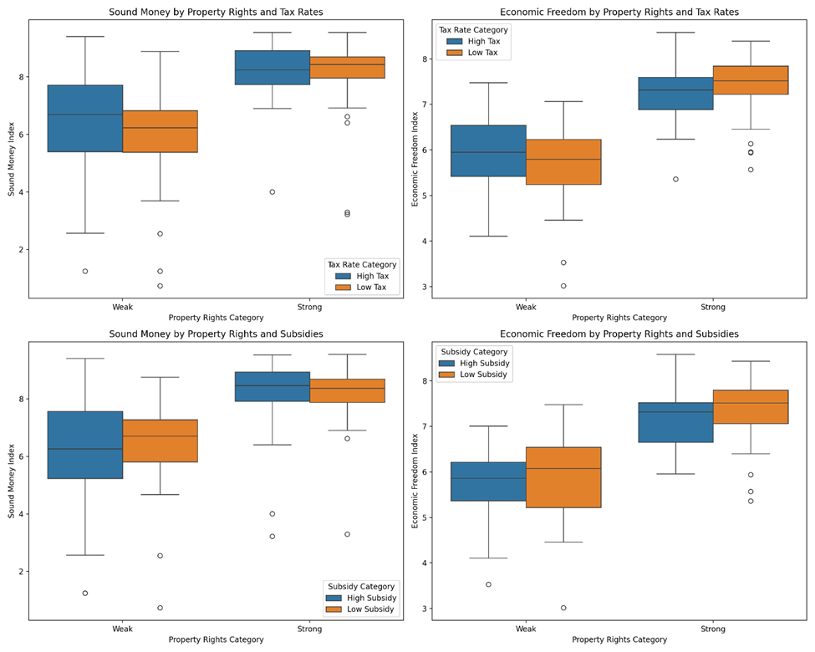
Analyze this relationship by combining these factors and examining their interactions
Property Rights and Tax Rates:
Countries with strong property rights maintain higher sound money and economic freedom indices regardless of tax rates
The negative impact of high tax rates is more pronounced in countries with weak property rights
In strong property rights countries, the correlation between tax rates and economic outcomes is relatively weak
High subsidies generally correspond with lower economic freedom scores, especially in weak property rights environments
Countries with strong property rights maintain better economic outcomes even with high subsidies
The combination of low subsidies and strong property rights shows the highest economic freedom scores

Slide 47
Combined Effects:
The best economic outcomes are observed in countries with:
Strong property rights
Low tax rates
Low subsidies
The worst outcomes are in countries with:
Weak property rights
High tax rates
High subsidies
Strong property rights protections can help mitigate some of the negative effects of high taxes and subsidies on economic freedom and monetary stability, but the optimal environment combines strong property rights with lower government intervention through both taxes and subsidies.

Slide 48
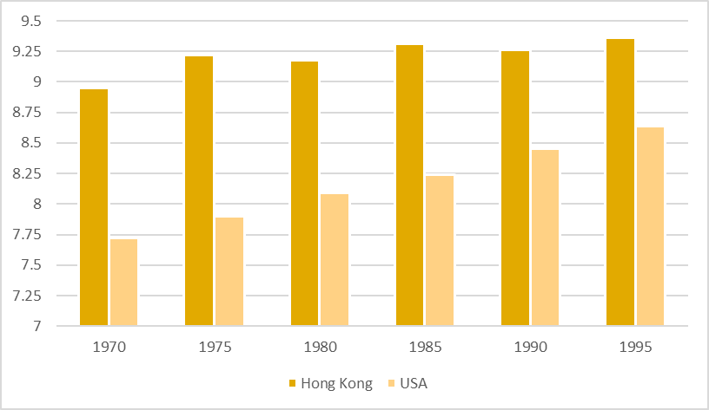
How has the overall economic freedom score changed from 1970 to 2022?
During the 1970s, various regions worldwide, particularly in developing nations, encountered diminished economic freedom resulting from government-directed economic strategies, trade limitations, and extensive regulations. Economies were frequently marked by nationalization, central planning, and protectionist policies.
By the mid-1990s, nations such as the U.S., Hong Kong, Singapore, and New Zealand were showcasing exceptionally high degrees of economic freedom.
The early 2000s saw ongoing advancements in economic freedom in numerous countries. Changes in developing countries, such as market liberalization and decreasing government control, contributed to an increase in worldwide economic freedom ratings.

Slide 49
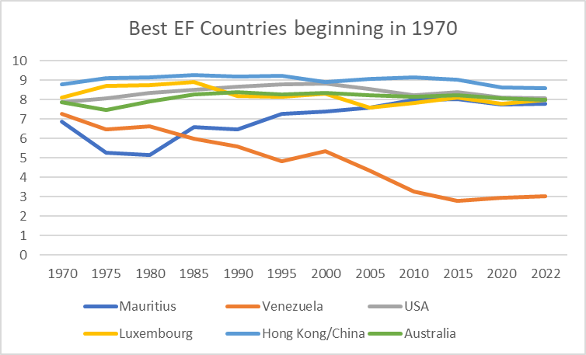
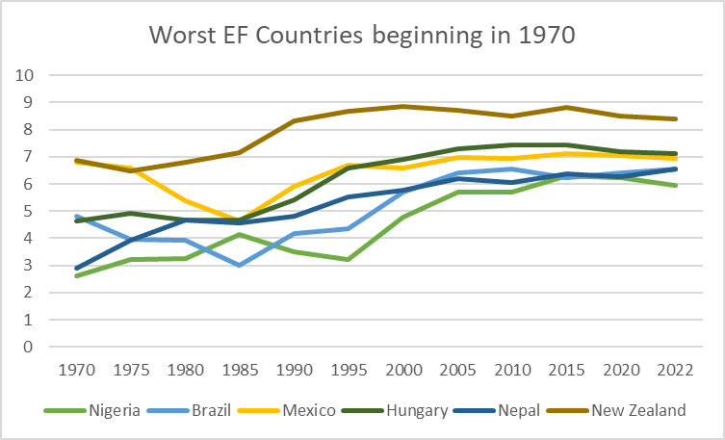
After 2000-s
The 2007-2008 global financial crisis (GFC) caused a short-lived adverse effect on economic freedom. Numerous nations reacted to the crisis by enhancing government involvement, implementing bailouts, and launching stimulus initiatives, leading to a decline in certain international economic freedom ratings.
The years between 2010 and 2020 exhibited a rather varied performance. Although numerous economies progressed regarding economic freedom, there were also regressions. Nations such as the U.S. saw a reduction in economic freedom during the early 2010s as a result of rising regulatory pressures and escalating public debt.

Slide 50
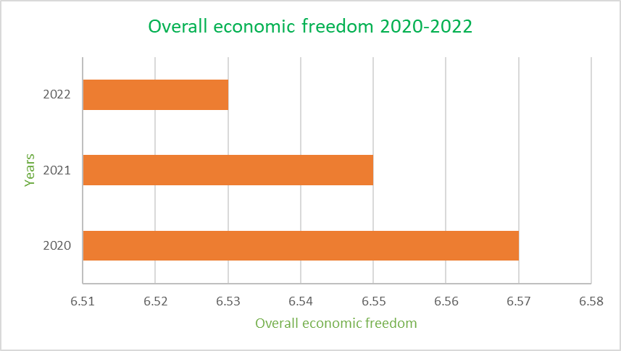
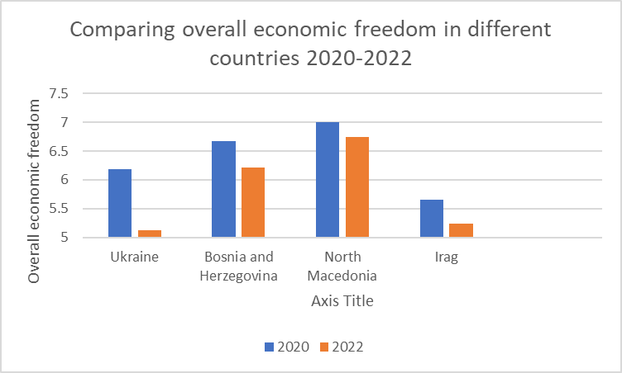
Covid time
The COVID-19 pandemic greatly influenced global economic freedom. Numerous governments heightened their control over economies via lockdowns, financial assistance, and urgent interventions. This resulted in a decline in economic freedom ratings in numerous nations in 2020. By 2022, several economies started to bounce back from the pandemic's severe effects, yet global economic freedom overall stayed quite stable. The Index from the Heritage Foundation showed minor advancements in certain nations, particularly in Asia and the Pacific, yet significant issues like inflation, geopolitical conflicts, and elevated public debt persistently impacted economic freedom ratings​.
​

Slide 51

Chart with overall economic freedom 1970-2022
This chart represents overall economic freedom from 1970-2022. We can see constant growth from 1970 to 2015. And then from 2020 economic freedom started to decrease. In 2020 we had covid period-big factor that could influence the overall score. Also conflicts between countries, wars, inflation can affect the overall score nowadays.

Slide 52

Thank you for your attention! We hope you enjoy our presentation!

